Slide 1
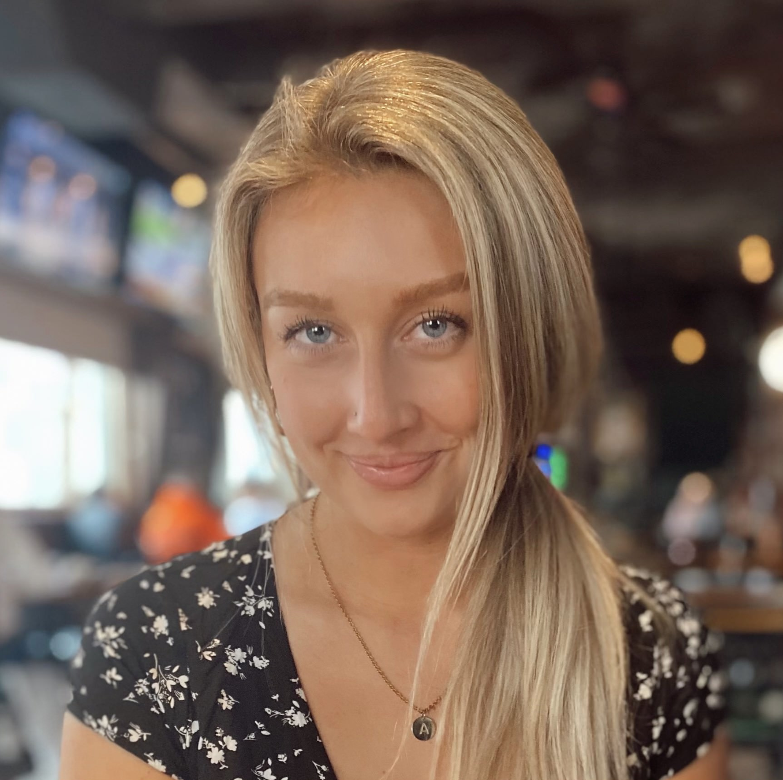
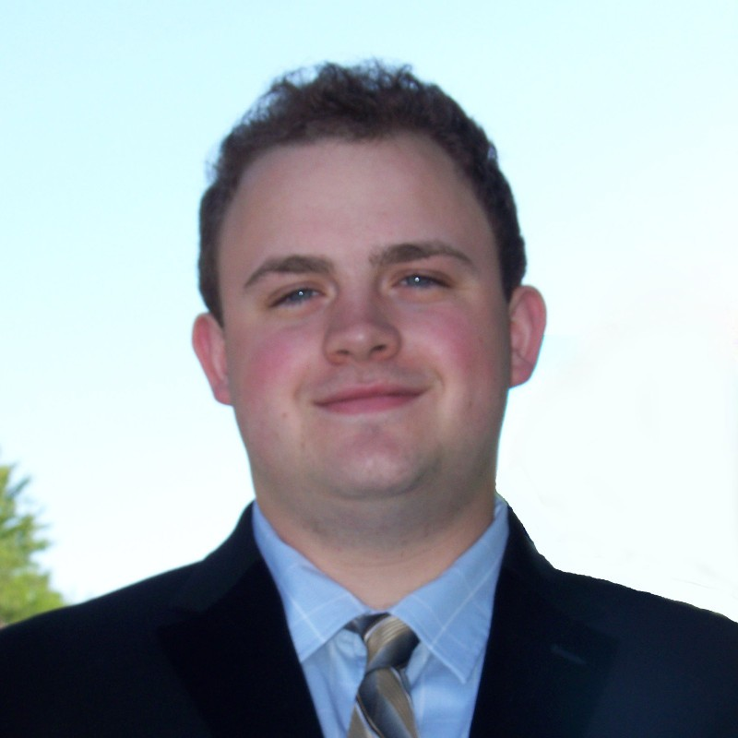
Spring 2022 Volume 2, Issue 3
The Doctor is In: Thoughts from Dr. Studwell
It’s hard to believe that it has been six months since my last column. Since then, we have celebrated a key milestone: RaceWeather is now in its 20th season. This foundational brand continues to bring together our racing and weather heritage. It’s difficult to see ExoConsulting existing without it. EC Sports Management now represents six drivers and two teams across four series for their business and marketing development. By offering a diverse set of clients, we are able to maximize our value in the sports management landscape. Finally, Chesapeake Analytics continues to bring new & innovative weather-centric
services to the commodity trading & broadcast media sectors. A revitalized partnership with CRCL Solutions, along with continued collaboration with industry leaders, Ambee, Prescient Weather, and tychoNova allow us to meet your meteorological and trading needs. As we approach our 2nd anniversary in June, our future has never looked brighter. Let’s find ways to work together.
Semper incendendo.
Meet Tomorrow’s Future Now
From understanding the nuances of sports journalism and media industries to meteorological trends that may affect motorsports events, ExoConsulting’s latest interns, Angela Puhl and Mark Sweeney, are ready to bring new concepts to a thriving organization in a new, post-pandemic normal in 2022.
ExoConsulting, founded by Dr. Aaron Studwell, a respected meteorologist in the NASCAR and motorsports industries, recently recruited Sweeney and Puhl to expand his vision for
for his platforms while strengthening their talents and knowledge in their respective fields. Certainly, Puhl and Sweeney possess the same desire of excellence for ExoConsulting and in their desired professional industries.
Beyond practical and valuable experiences gained through their internships, Sweeney & Puhl are utilizing next generation platforms, primarily social media, to further their reach as individuals and for the organization. This young talent isn’t only making a name for themselves but in the mold of ExoConsulting they’re resilient, resourceful and ambitious.
For more information,
please visit ExoConsulting.net
Aaron Studwell, Ph.D.
Aaron.Studwell@ExoConsulting.net
302-827-3370

